Slide 1
Computer Architecture Concepts
Part 2 – Combinatorial Circuits

Slide 2
Objectives
To look at concepts of combining gates into more complex circuits
Called combinatorial (or combinational) circuits

Slide 3
Simple Circuits
We create combinatorial circuits by connecting the output of one gate to the input of another
For these circuits, the final outputs depend only on the combination of inputs
We can use a truth table and our knowledge of the basic logic gates to work out the behaviour of a circuit with multiple inputs and outputs.
A | B | C | X | Y
0 | 0 | 0
0 | 0 | 1
0 | 1 | 0
0 | 1 | 1
1 | 0 | 0
1 | 0 | 1
1 | 1 | 0
1 | 1 | 1
0
1
0
1
0
1
0
1
0
0
0
1
1
0
1
1

Slide 4
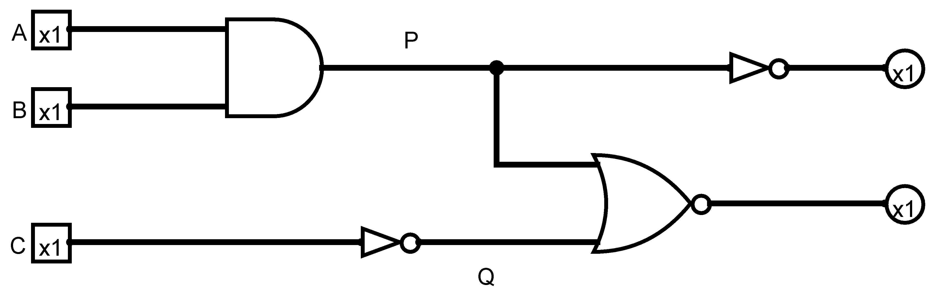
Intermediate Results
With complex circuits we can use intermediate results to help construct the final truth table.
A
B
C
P
Q
X
Y
0
0
0
0
1
1
0
0
0
1
0
0
1
1
0
1
0
0
1
1
0
0
1
1
0
0
1
1
1
0
0
0
1
1
0
1
0
1
0
0
1
1
1
1
0
1
1
0
0
1
1
1
1
0
0
0

Slide 5
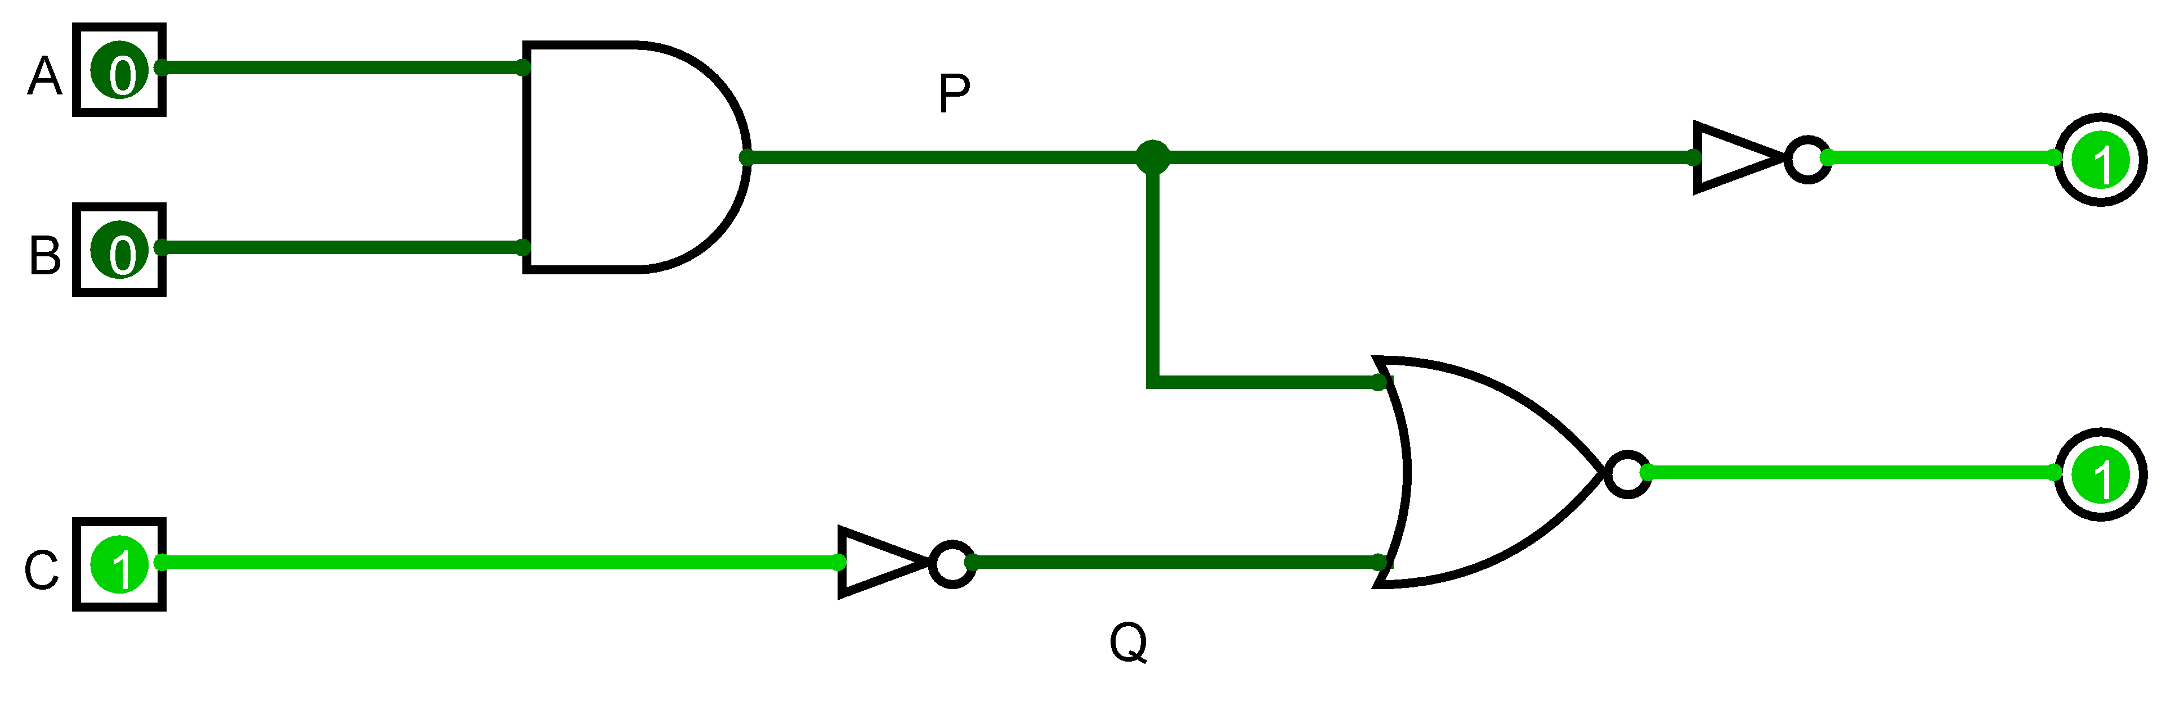
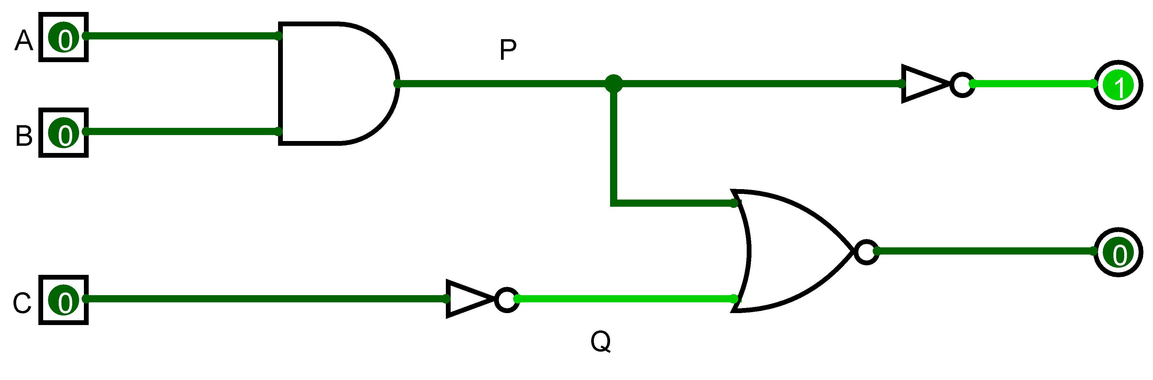
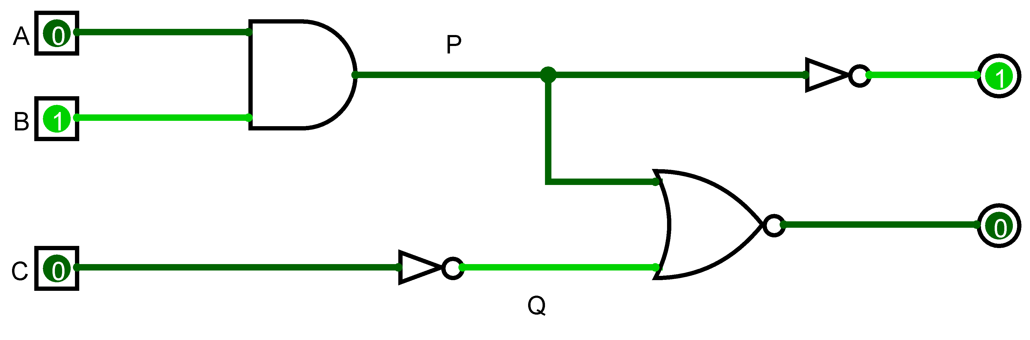
Logisim Example
We could check our truth table by systematically trying every combination

Slide 6
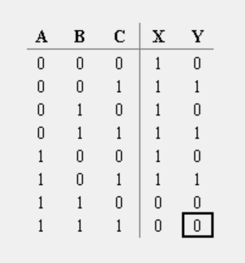
Logisim Example
Logisim can generate the truth tables for us
A | B | C | P | Q | X | Y
0 | 0 | 0 | 0 | 1 | 1 | 0
0 | 0 | 1 | 0 | 0 | 1 | 1
0 | 1 | 0 | 0 | 1 | 1 | 0
0 | 1 | 1 | 0 | 0 | 1 | 1
1 | 0 | 0 | 0 | 1 | 1 | 0
1 | 0 | 1 | 0 | 0 | 1 | 1
1 | 1 | 0 | 1 | 1 | 0 | 0
1 | 1 | 1 | 1 | 0 | 0 | 0

Slide 7
Summary
Basic logic gates are combined to create more complicated circuits
We can work out the behaviour using a truth table
Logisim can generate the truth table for us for combinatorial circuits

